Slide 1
Object Design Document Template

Slide 2
1. Introduction
trade-offs made by developers (e.g., buy vs. build, memory space vs. response time), guidelines and conventions (e.g., naming conventions, boundary cases, exception handling mechanisms), and an overview of the document.
Interface documentation guidelines include a list of rules that developers should use when designing and naming interfaces. Examples:
Classes are named with singular nouns.
Methods are named with verb phrases, fields, and parameters with noun phrases.
Error status is returned via an exception, not a return value.
Collections and containers have an iterator() method returning an Iterator.
Iterators returned by iterator() methods are robust to element removals.

Slide 3
2. Packages
describes the decomposition of subsystems into packages and the file organization of the code. This includes an overview of each package, its dependencies with other packages, and its expected usage.

Slide 4
3. Class Interfaces
describes the classes and their public interfaces. includes
an overview of each class,
its dependencies with other classes and packages,
its public attributes, operations, and
the exceptions they can raise.

Slide 5
Usage of Javadoc
Both packages and class interfaces can be generated from source code (comments)! By using a tool, which is named Javadoc

Slide 6
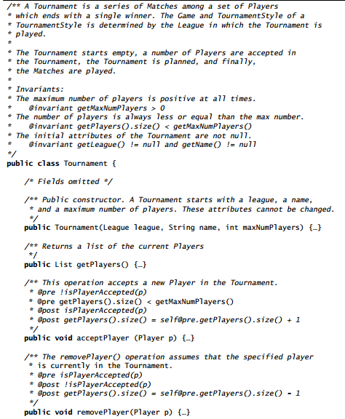

Slide 7
The header comment in the file describes the purpose of the Tournament class, its authors, its current version, and cross references to related classes.
The @see tags are used by Javadoc to create cross references between classes.
Following the header comment is the class and the method declarations.
Each method comment contains a brief description of the purpose of the method, its parameters, and its return result.
When using constraints, we also include preconditions and postconditions in the method header.
The first sentence of the comment and the tagged comments are extracted and formatted by Javadoc.
Keeping material for the ODD with the source code enables the developers to maintain consistency more easily and rapidly.

